Slide 1
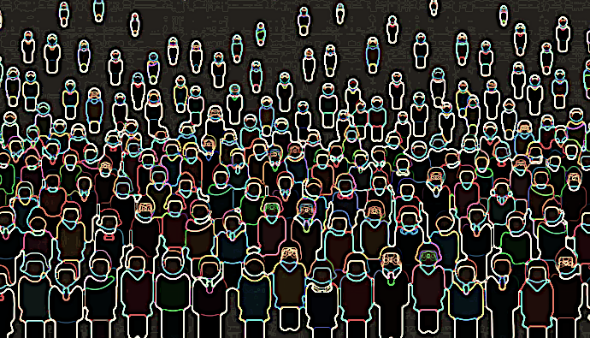
GEOG128 - Human Geography: Space, Place and Community
Week 4: Health geographies recap and midterm preparation session
Dr Jonathan Cinnamon | Human Geography| Department of Community, Culture, and Global Studies

Slide 3
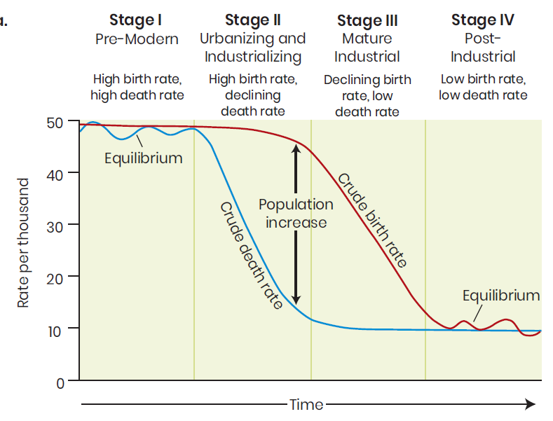
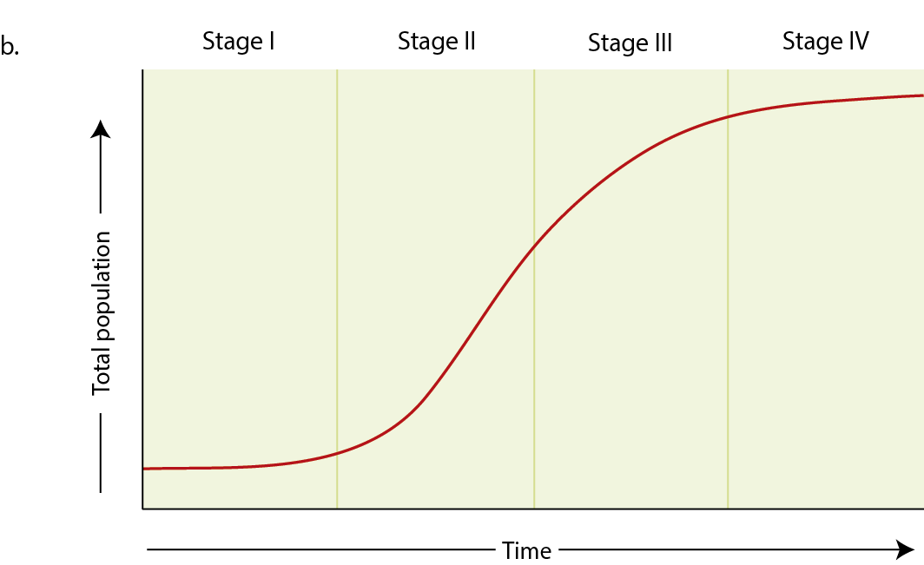

The Demographic Transition model
The transition from high birth and high death rates to lower birth and lower death rates, as a country or a region develops from a pre-industrial economy to an industrialized economy

Slide 4
Epidemiological Transition Model
“Conceptually, the theory of epidemiologic transition focuses on the complex change in patterns of health and disease, and interactions between these patterns and their demographic, economic and sociologic determinants and consequences” (Omran 1971, 161)
mortality is a fundamental factor in population dynamics
Proposition 1
a long-term shift occurs in mortality and disease patterns whereby communicable diseases are gradually displaced by non-communicable diseases as the primary cause of death
Proposition 2
Proposition 3
During the epidemiologic transition the most profound changes in health and disease patterns are in children and young women
Proposition 4
The shifts in health and disease patterns are closely associated with the demographic and socioeconomic transitions that constitute the modernization complex
Omran, A. R. (1971) The epidemiologic transition: a theory of the epidemiology of population change. The Milbank Memorial Fund Quarterly, 509-538.

Slide 5
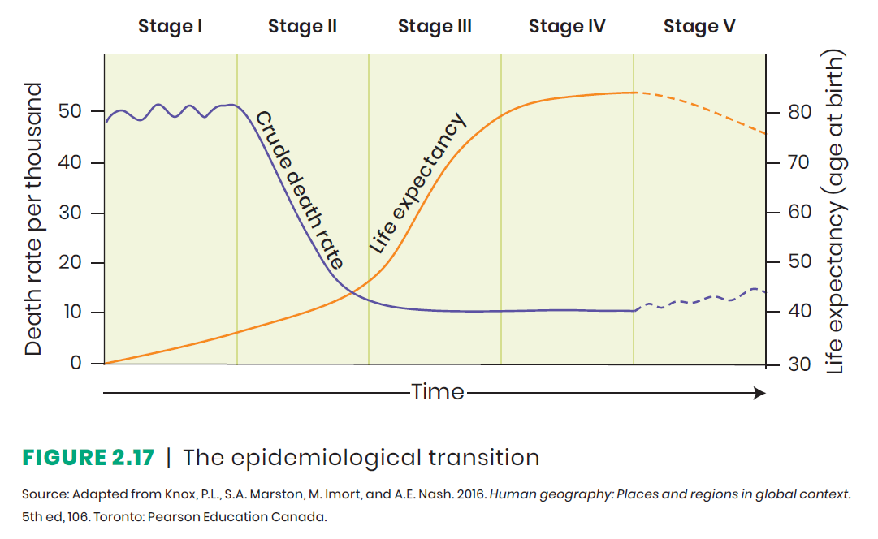
The Epidemiological Transition
Shift in prevalence of types of disease
Corresponds to demographic transition
Four stages
Age of pestilence and famine
Age of receding pandemics
Age of degenerative diseases
Age of delayed degenerative diseases
Re-emergence of infectious disease? (Stage 5)

Slide 6
‘Re-emerging’ Diseases

Slide 7
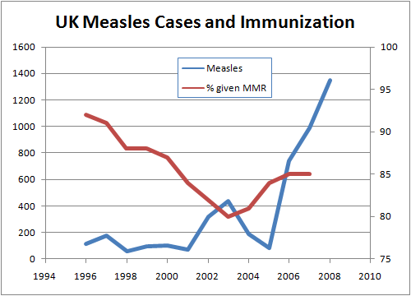
‘Re-Emerging’ infectious diseases and the epidemiological transition model
93%
‘Herd immunity’
85%
http://granades.com/2009/02/09/the-evil-that-men-do-lives-after-them/

Slide 8
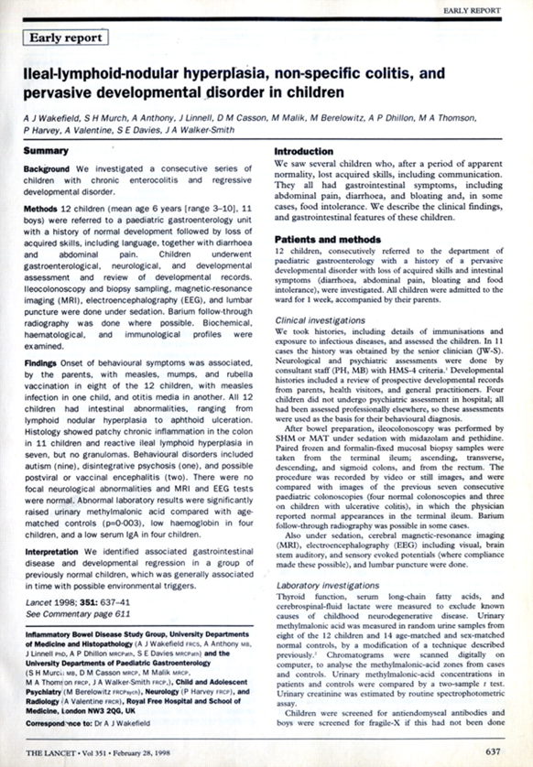



MMR- Autism link?
Published 1998
Retracted 2010

Slide 9
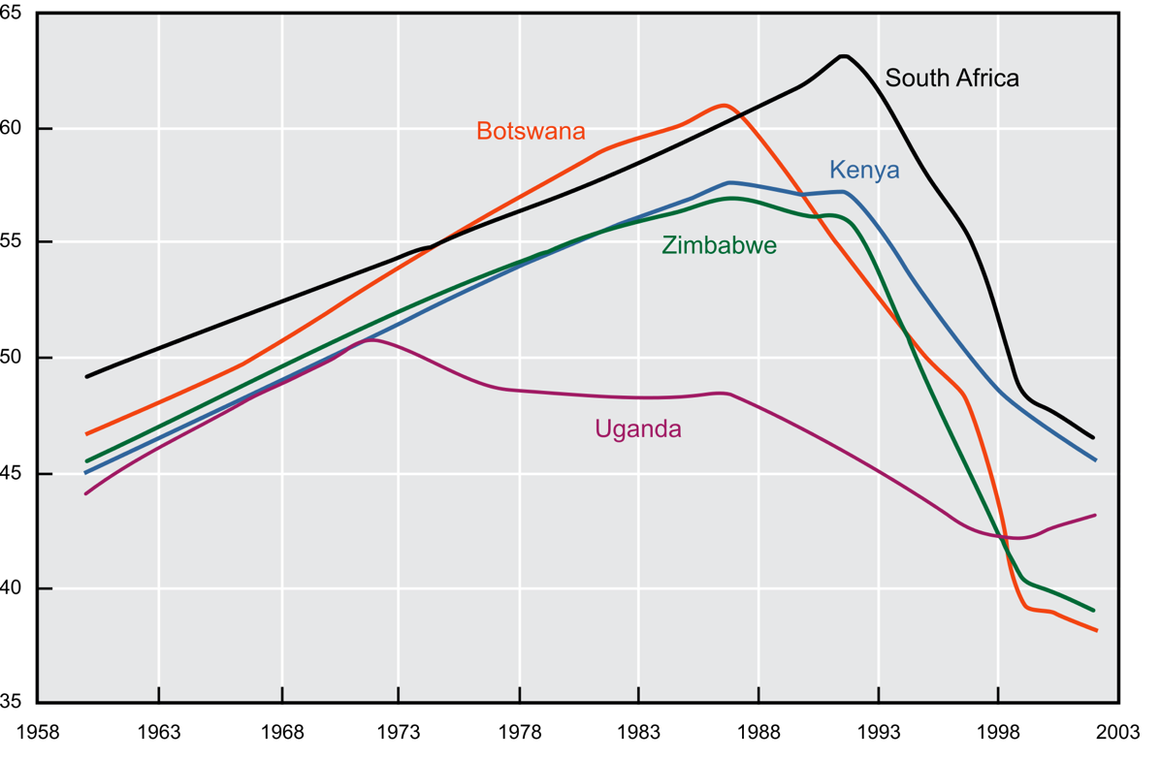
Emerging infectious diseases and the epidemiological transition model
Life expectancy

Slide 10
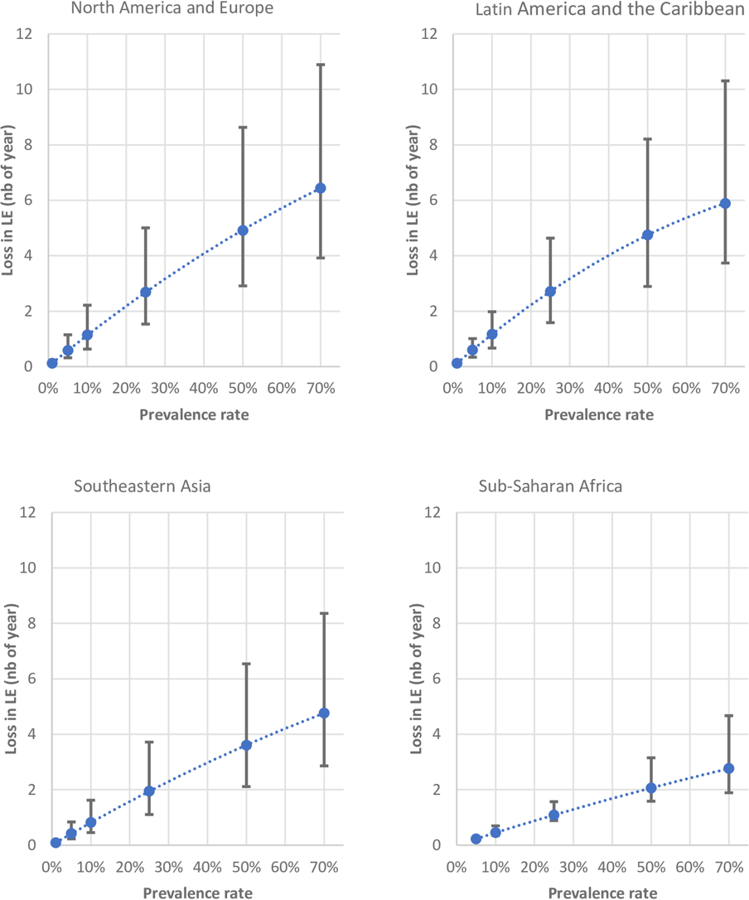
Emerging infectious diseases
Estimated loss of life expectancy due to COVID-19
“unless we can contain the spread of Covid-19, it will most likely result in a reduction in life expectancy in those regions that are most affected by the disease” (Forbes)
Marois G, Muttarak R, Scherbov S (2020) Assessing the potential impact of COVID-19 on life expectancy. PLOS ONE 15(9): e0238678. https://doi.org/10.1371/journal.pone.0238678

Slide 11
Covid maps
Johns Hopkins Covid 19 data

Slide 12
Covid maps: normalized
Johns Hopkins Covid 19 data

Slide 13
Covid maps: Proportional symbols
Each circle is scaled according to the number of cases within each of the countries
Johns Hopkins Covid 19 data

Slide 14
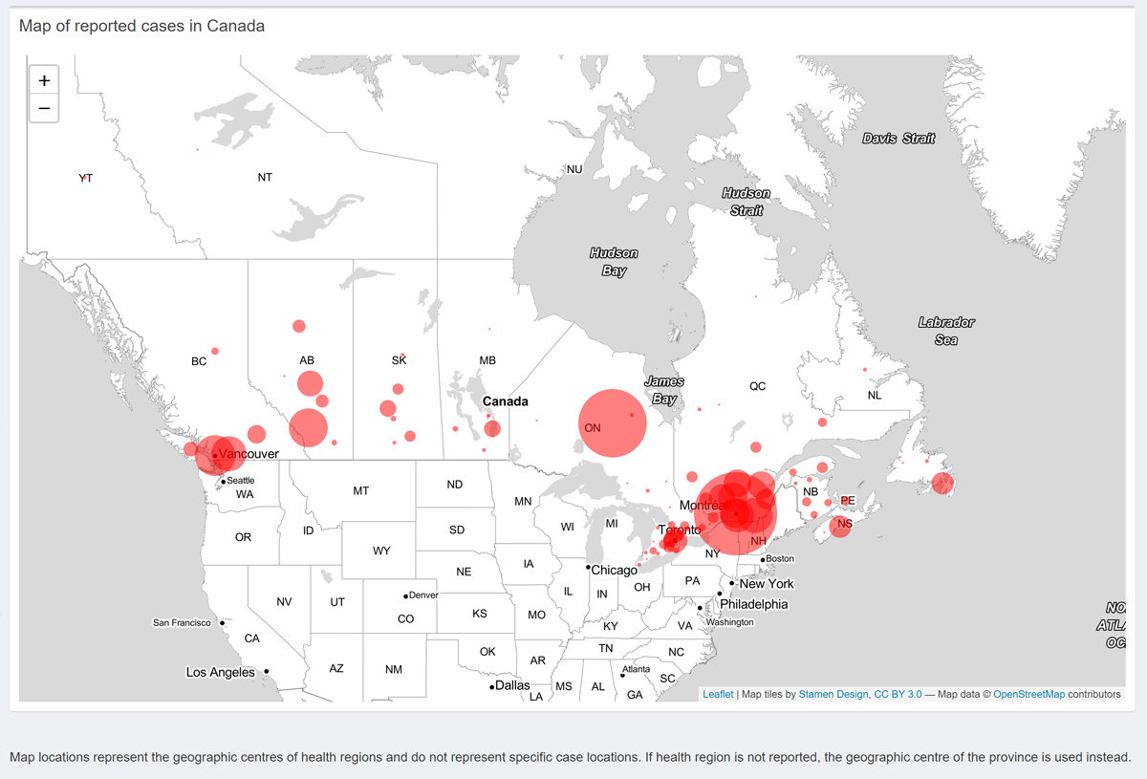
Covid maps: Proportional symbols
https://cangeo-media-library.s3.amazonaws.com/s3fs-public/images/web_articles/covid-19_in_canada_1200_march31.jpg

Slide 15
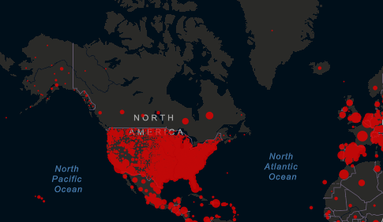

Slide 17
Midterm 1(worth 20% overall)
covers weeks 1-4 (lectures, activities, course material, textbook chapter 1-2).
available through Canvas>Quizzes, from 8 am to 8pm on Tuesday Feb 8th.
Two hours maximum to complete the midterm (unless you have accommodations).
Once you start the quiz, the 2-hour time limit begins. Complete your work in a Word document, clearly indicate each question you are answering, and upload the document at or before the 2-hour limit.
You will answer 5 questions out of a choice of 8
Each question is worth 4 marks each
Each answer may be no more than 6 sentences.
Open book exam

Slide 18
Explain why locations are places to some people and not to others.
Differentiate between reference and thematic maps.
Differentiate among the three types of regions and provide examples of each.
Explain how different types of stores illustrate distance decay.
Differentiate between latitude and longitude.

Slide 19
Explain how flooding in British Columbia can have far-reaching consequences.
Identify the various factors that explain and account for migration.
Explain the demographic transition model.
Differentiate between a pandemic and an epidemic, using examples.
Compare and contrast two types of migration. Provide specific examples of each from history.

Slide 20
2. Explain and differentiate between reference and thematic maps
Reference maps are used to accurately communicate information to map readers about locations of geographic phenomena, such as cities, points of interest, buildings, and physical geographic features. Some examples of reference maps include topographical maps and street maps. Thematic maps are used for analytical purposes, to help solve a problem or to show spatial patterns and trends. They often illustrate spatial concepts, such as the distribution or diffusion of geographic phenomena. Some examples of thematic maps include dot maps, choropleth maps, and cartograms.

Slide 21
Midterm tips and questions
What is a short answer question?
More than a definition, but not an essay question
Focus is on explaining/differentiating/comparing/contrasting etc.
Quality/appropriateness of your examples is important
Draw on any material from this section of the course
How long should answers be?
6 sentences max
Length is not as important as quality of answer
Do not just copy information from the textbook/lectures verbatim

Slide 22
Midterm tips and questions
What should I focus my studying on?
All lectures, assigned material, reading, activities etc. are possible sources of questions
Notes:
Go beyond definitions

